Slide 1
Content Management Systems 3
CS272: Introduction to Web Development
Cole Nelson | Computer Sciences

Slide 2
Discussions, Quizzes, and Grading
DIS A and HW0 graded! Begin working on DIS B and HW1. Quiz A next week on CMS.

Slide 3
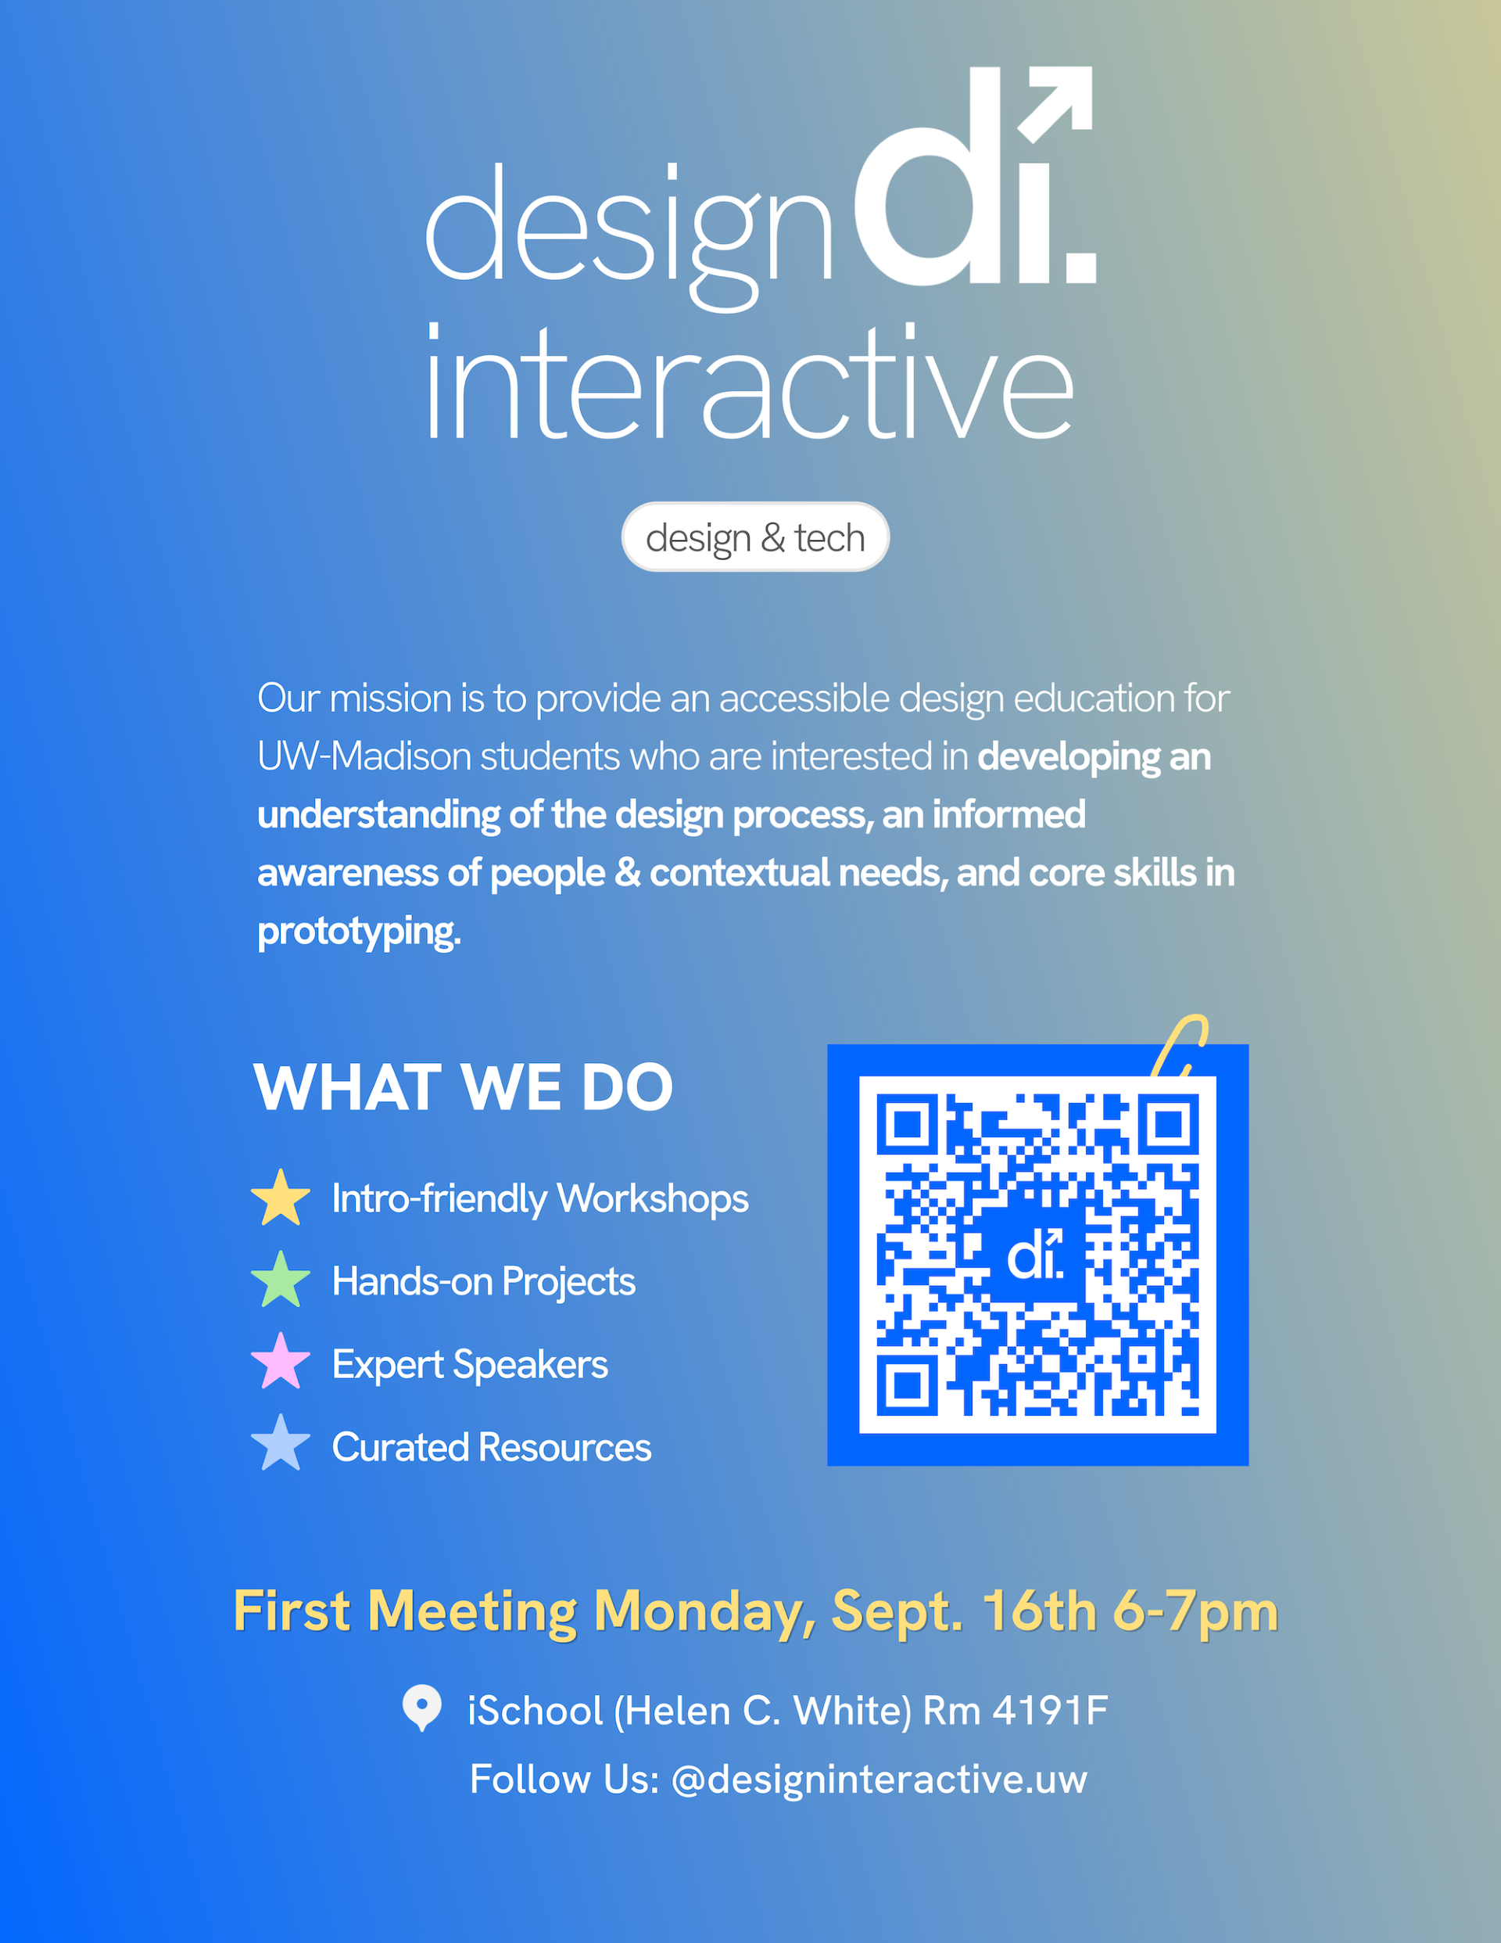
Interested in design? Check out the Design Interactive student organization!
https://www.designinteractive-uw.com/

Slide 4

Before we begin…
Make sure you have an About Me, My Work, Blog, and My Secret Page pages. Put whatever as their content!

Slide 5
Learning Objectives
After this lecture, students should be able to…
Understand the difference between unsynced patterns, synced patterns, and template parts.
Modify and create theme templates.
Customize navigation menus.
Add and manage users into appropriate roles.
Configure website settings including…
Setting URL patterns.
Setting the homepage and blog page.
CS272 | Introduction to Web Development | CMS 3

Slide 6
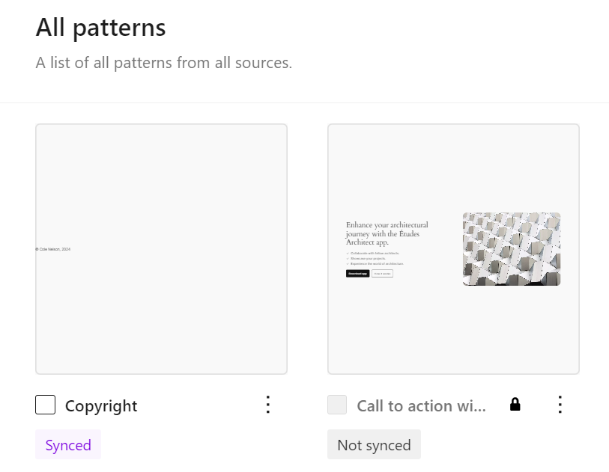
Patterns
Patterns can be synced or not synced.
A pattern that is synced will look the same everywhere that it is used!
A pattern that is not synced can be changed to meet the needs of a specific part of the webpages that it is being used.
CS272 | Introduction to Web Development | CMS 2

Slide 7
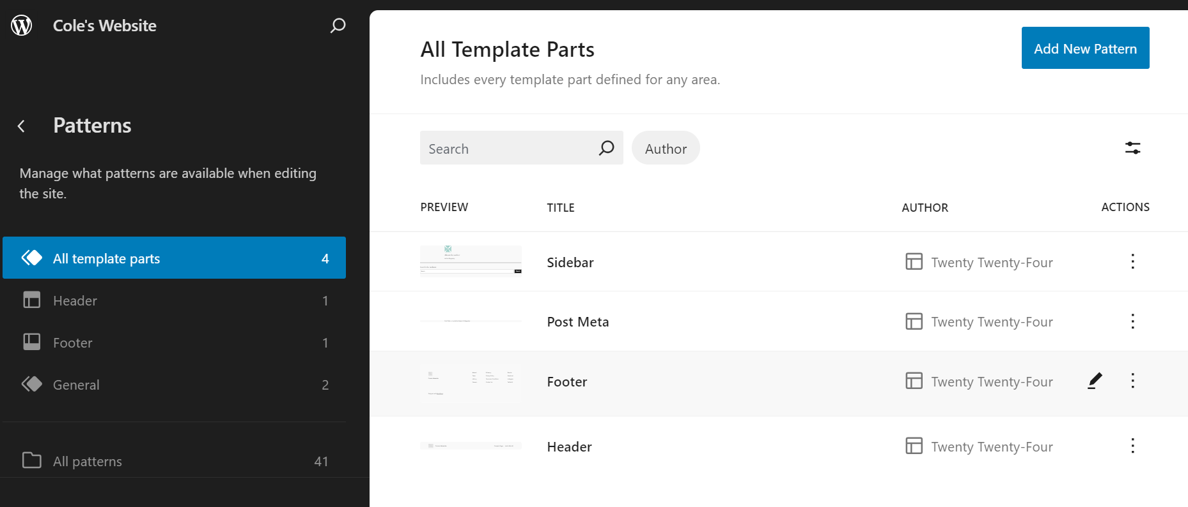
Template Parts
A template part is a synced pattern used in specific structural parts of a theme (e.g. header, footer)
CS272 | Introduction to Web Development | CMS 2

Slide 8
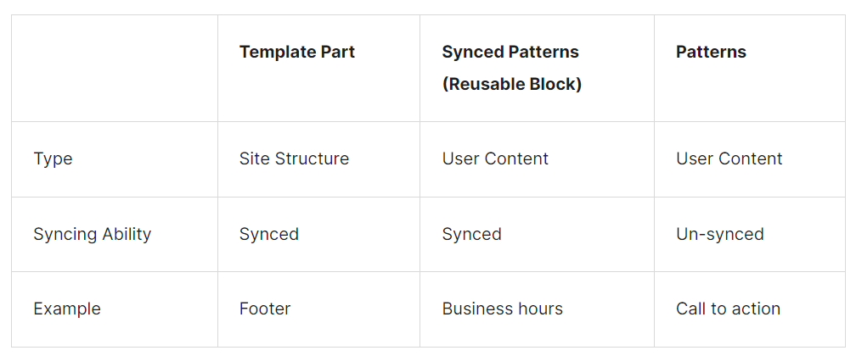
Unsynced Patterns, Synced Patterns, and Template Parts
View the full article here!

Slide 9
Your turn!
Customize the Sidebar, Header, and Footer template parts.

Slide 10
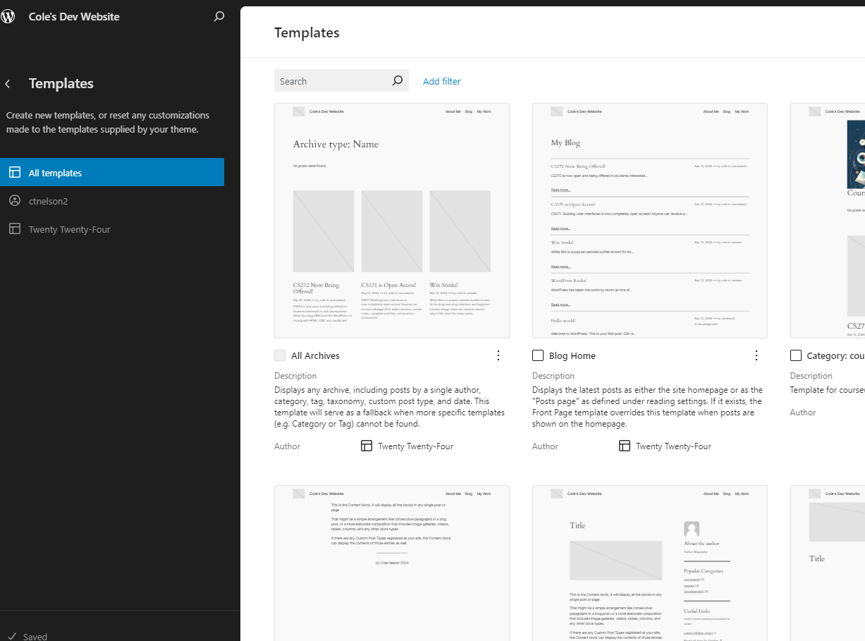
Templates
Define specific representations for the website, as dictated by the theme.
Often make use of many “template parts”.
e.g. Blog Home is a template that defines your homepage (for now!)

Slide 11
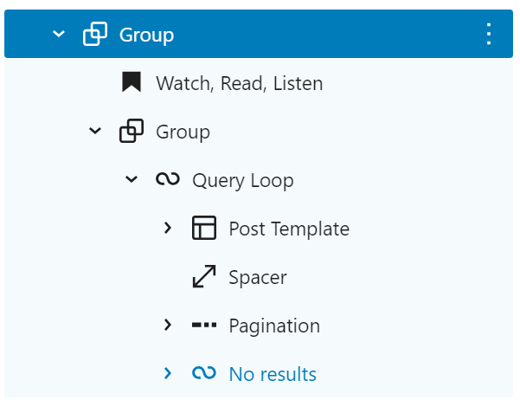
Templates
Template often make use of blocks we haven’t seen before!
These usually consist of dynamic content, that changes based on the page that is being displayed.

Slide 12
Your turn!
Change the Blog Home template to accurately reflect you!

Slide 13
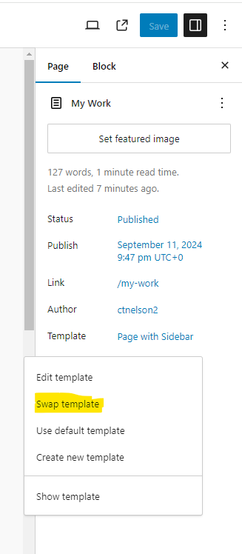
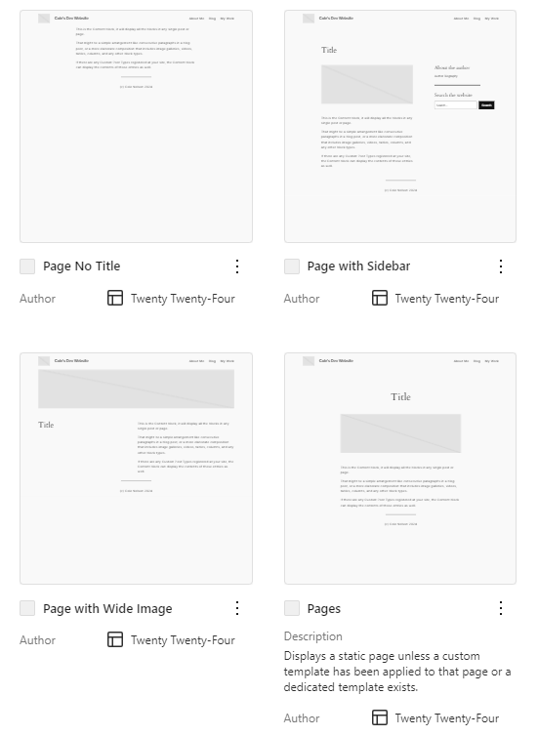
Templates
You can choose what template you are using for your page or post! e.g.
Page No Title
Page with Wide Image
Page with Sidebar
Page (Default)

Slide 14
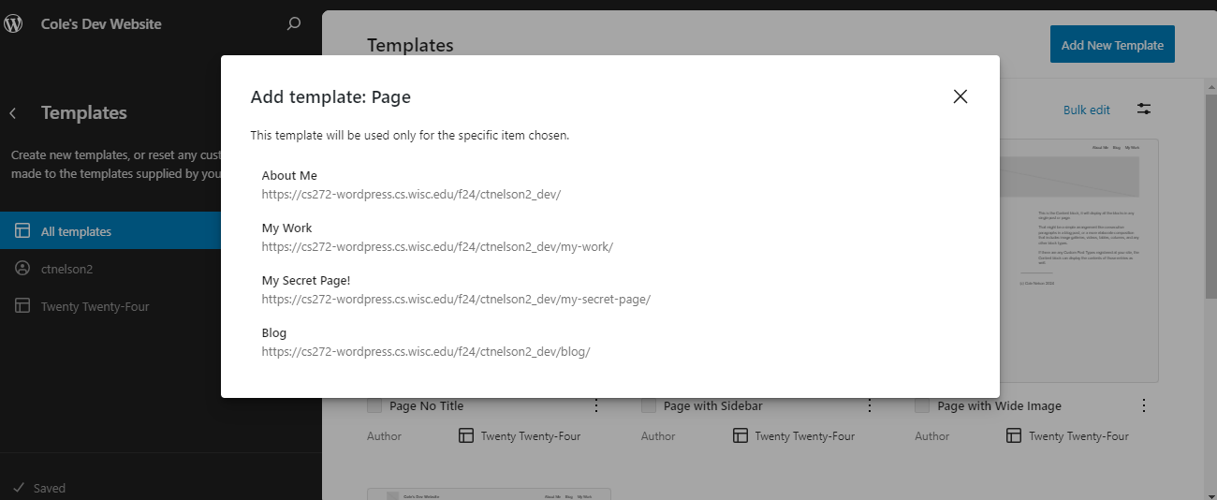
But… I have a special page!
There exists a template hierarchy.

Slide 15
Your turn!
Create a custom template for one of your pages.

Slide 16
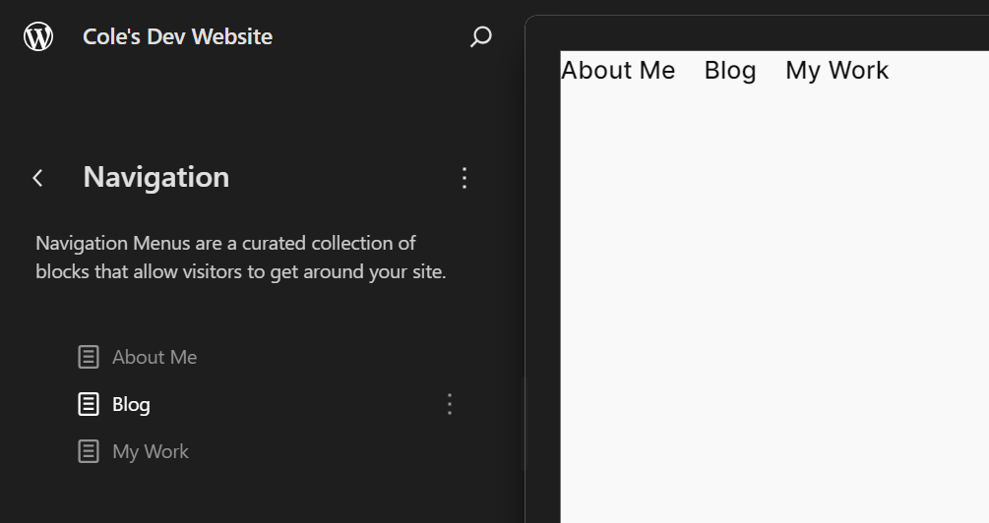
Navigation
Editing the Navigation will cause it to de-sync, meaning you’ll have to manually add pages in the future. That’s okay!

Slide 17
Your turn!
Change the Navigation to hide your Secret Page!

Slide 18
Users
Administrator – somebody who has access to all the administration features within a single site.
Editor – somebody who can publish and manage posts including the posts of other users.
Author – somebody who can publish and manage their own posts.
Contributor – somebody who can write and manage their own posts but cannot publish them.
Subscriber – somebody who can only manage their profile.
From WordPress.org

Slide 19
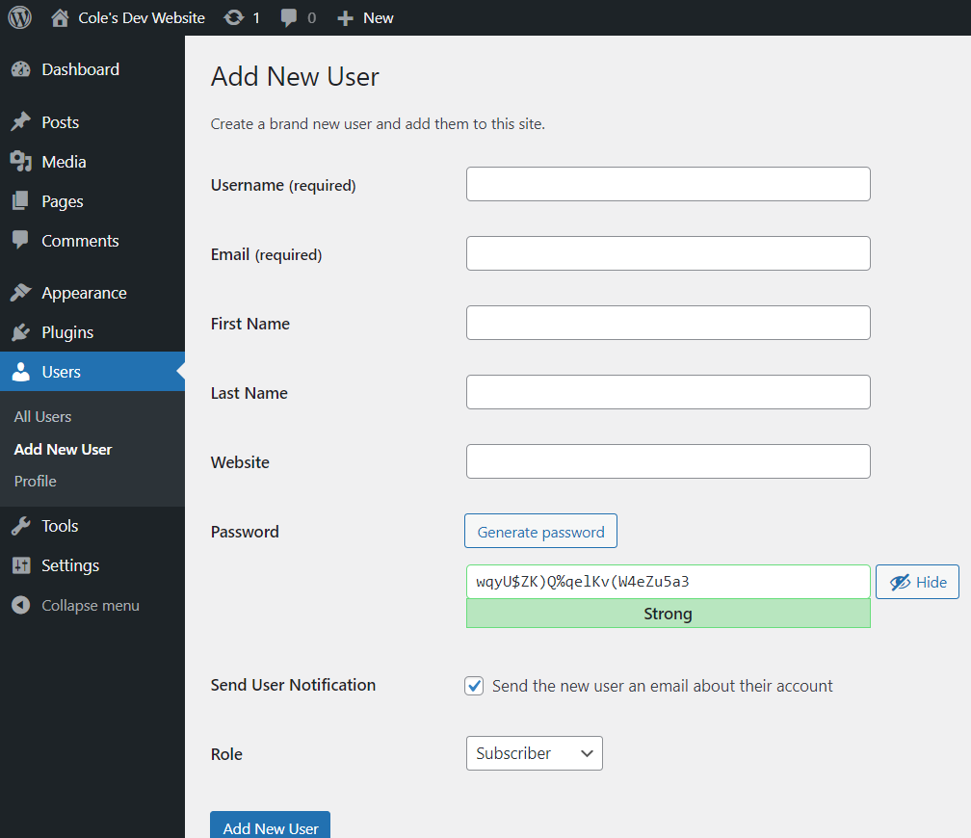
By default, you are the only user! You can add others, or…

Slide 20
Your turn!
Create a new user as either a Contributor or Author. See how their view differs from yours!

Slide 21
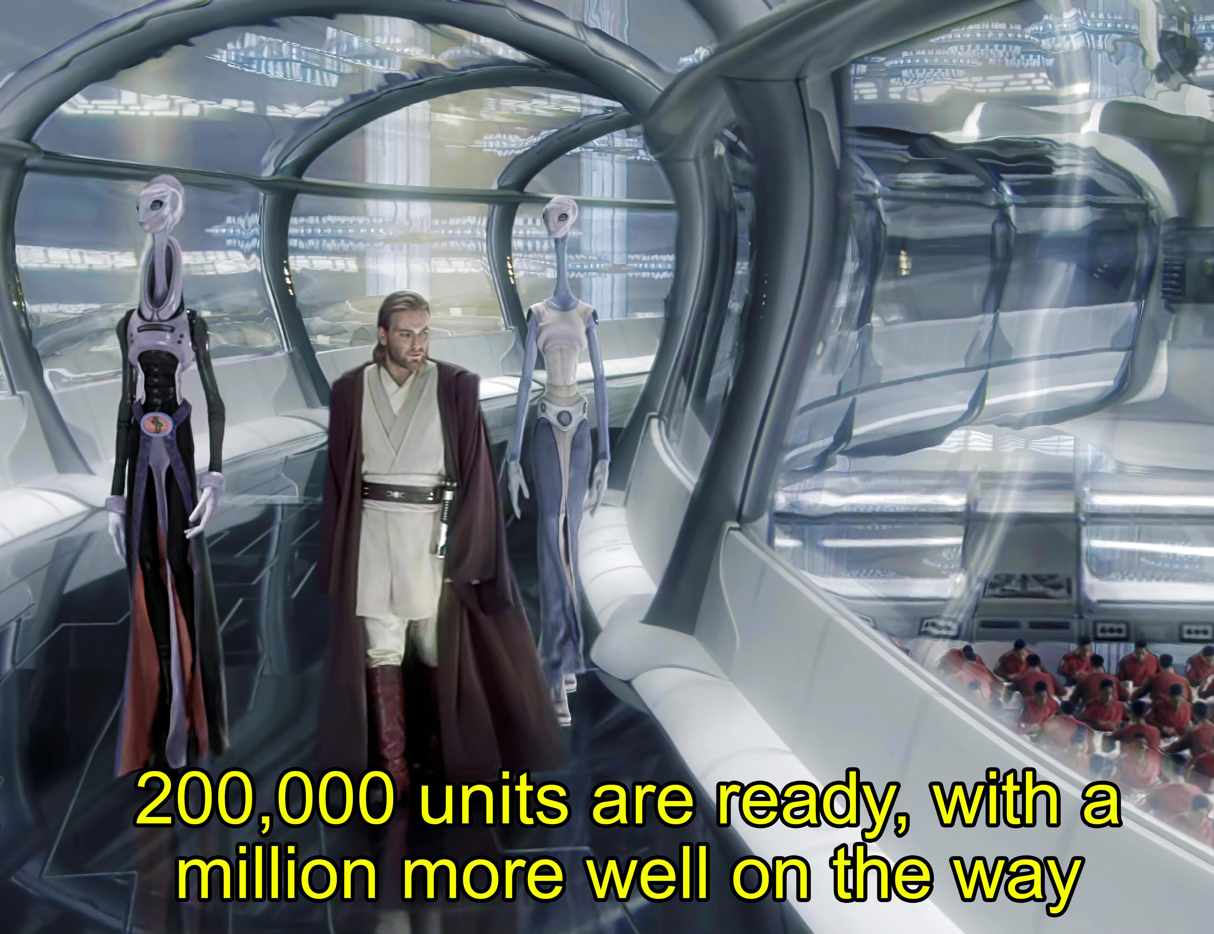
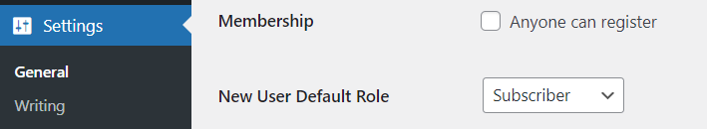
You can allow self-signup, just beware of the bots! ☺
Note that self-signup will only work with a valid emailer!
Star Wars: Attack of the Clones

Slide 22
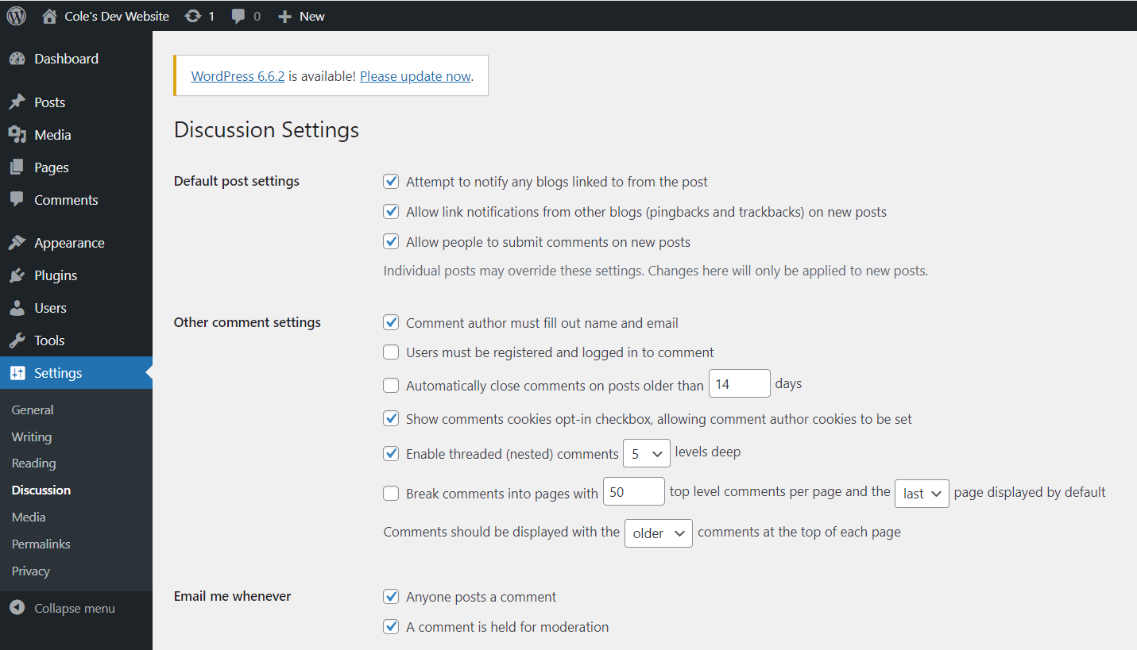
…so have appropriate discussion settings!

Slide 23
Your turn!
Make a comment on your neighbor’s post. Remember, they still get a chance to moderate it!

Slide 24
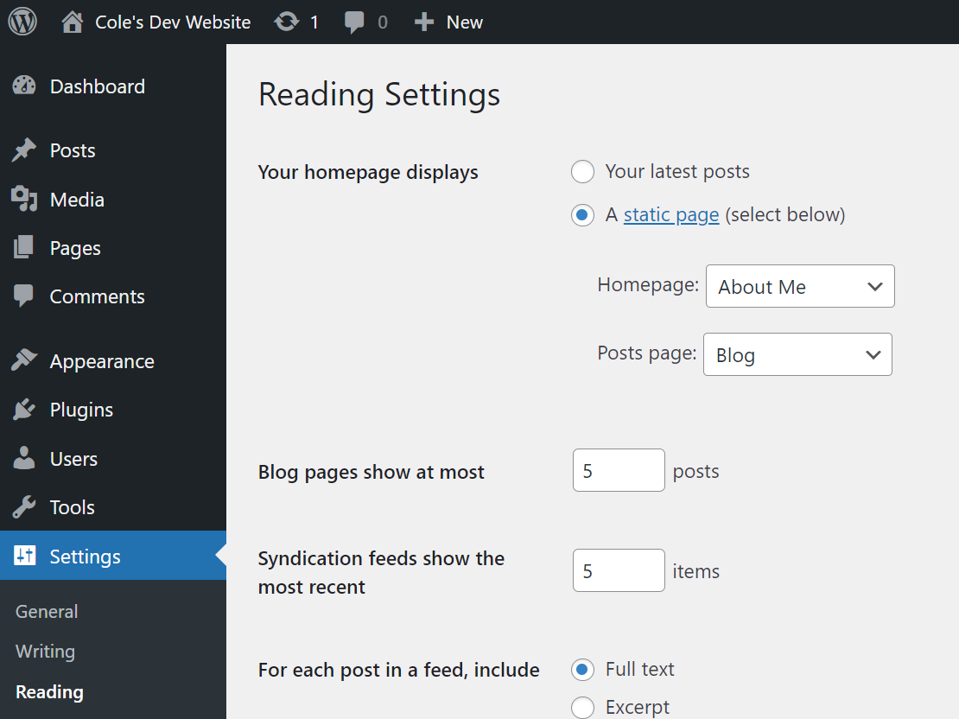
You can specify the homepage as your Blog Home or another page.

Slide 25
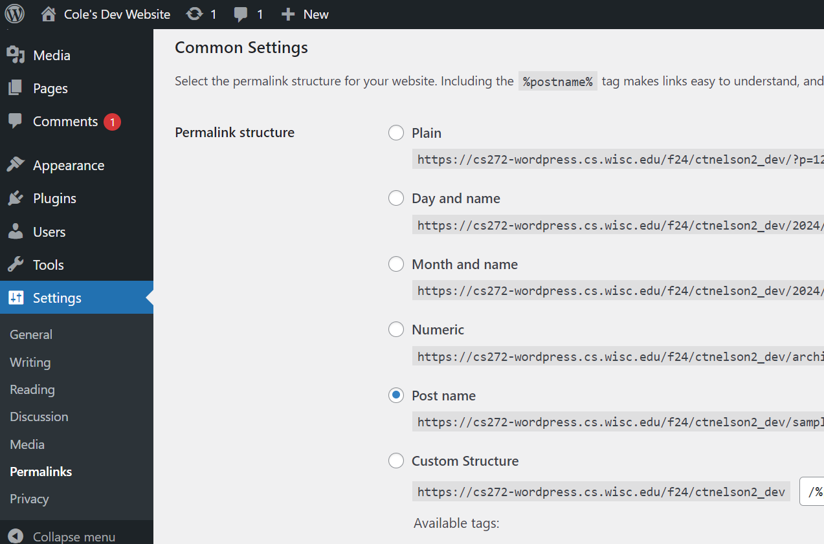
You can specify the URL “permalink” structure in several ways.

Slide 26
Your turn!
Explore the Settings of WordPress

Slide 27
A look into plugins…
… if we have time!

